Slide 1
Basic Stats
With Paul Garrett

Slide 2
Key Terms
Type I and Type II Errors (The boy who cried wolf)
Type I: The boy cries wolf, the village believes him; but the wolf was not there (False Positive)
Type II: The boy cries wolf, the village does not believe him; the wolf was there (False Negative)

Slide 3
Key Terms
P-values
A P-value (alpha) is the probability of finding a value equal to, or more extreme, than your observation; given that the null hypothesis is true.
What do p values provide?
With a p value, we provide a statistical test for the evidence against the H₀ ; or we fail to reject the alternative hypothesis H_{A}
Note: H_{A} can be any hypothesis that is not ‘the same as before’ or Null.
As a consequence, a p-value always provides evidence against the Null
e.g., p = 0.01, suggests the probability of the Null being True given your data, is less than 0.1%. This is why p values are always written ‘backwards’ ;)

Slide 4
Key Terms
Degrees of Freedom
Population = [1,2,3,4,5]
An all knowing being (omniscient) knows the population.
If this being were presented with the following sample [1,2,3,4,X], they would know that X = 5
This is because every Other value has been accounted for in the population, as such X can only ever be one value (5).
Therefore, the sample has 4 values that may change (also known as parameters) freely; and one that must be fixed
This means there are 4 degrees of freedom, or n - 1

Slide 5
The Purpose of Statistics
True Population
Sample
Statistics are used to:
Make an inference about the distribution of a population, from a sub-sample (hence forth sample)
Compare samples and decide if they originate from the same population

Slide 6
Central Limit Theorem
True Population
As the number of samples increases, the sample distribution will become normally distributed.
This occurs regardless of the sample population

Slide 7
Central Limit Theorem
True Population
With small samples, your sample mean may vary
For example, the mean of the Red distribution and Yellow distribution are very different
Mean1
Mean2

Slide 8
Central Limit Theorem
True Population
With an increase in sample, for example if we combine the two distributions, the sample mean will reflect the population mean
Note: This is regardless of the Shape of the Population Sample
Mean

Slide 9
Central Limit Theorem
True Population
And with ever increasing samples, the sample distribution will become normally distributed
This is the Central Limit Theorem.
Note: You will never know the true distribution of the population without sampling everyone. Mostly, this is not feasible.
Mean

Slide 10
Central Limit Theorem
True Population
Alternate Population
Understanding the properties of the Normal Curve allows powerful inference to be made about the population
But these inferences must also be checked against the assumption that the population is also normally distributed
Mean

Slide 11
Central Limit Theorem
True Population (HEIGHT)
Luckily, many phenomena we study adhere to Central Limit Theorem and as such, are normally distributed e.g., Height
This means we can make assumptions about these populations using properties of the normal curve
Mean

Slide 12
Central Tendency
True Population
The Normal Distribution is useful for describing a sample
But how do we describe the Normal Distribution?
Through our understanding of Central Tendency

Slide 13
Central Tendency
True Population
A sample will eventually reflect the average of the distribution (regression to the mean), as such the average or mean is very useful
Mean

Slide 14
Central Tendency
True Population
A sample will eventually reflect the average of the distribution
This is also know as regression to the Mean.
As such the average or mean of a distribution is very useful
Mean

Slide 15
Central Tendency
True Population
If the distribution has outliers, the mean will be influenced
However, the middle point or Median, will be less affected.
In skewed distributions, the Median can be invaluable (of course, skewed distributions never double over but you get the idea!)
Median
Mean

Slide 16
Quick Note: Skew
The Tail of the distribution points the direction of Skew!
Negative Skew (tail points negative)
Positive Skew (tail points positive)

Slide 17
Central Tendency
True Population
If you are interested in counts, then you might want to know the most frequent sample
This is known as the Mode
Mode

Slide 18
Central Tendency
True Population
The Shape of a distribution is also dictated by the Variance in the data
To understand Variance we must start with its initial measure, the sum of squares (SS)
True Mean

Slide 19
Central Tendency
True Population
Sum of Squares describes the distribution of individual samples from the mean
In red, we have 5 samples. Each sample can be described by their positional order i
Lets give these samples an order
x_{i}
x_{i}
x_{i}
x_{i}
x_{i}

Slide 20
Central Tendency
True Population
Now our X values have an order.
And we can calculate a mean, x̄
x̄ = sum( x_{1,} x_{2,} x_{3,} x_{4,} x₅ ) / n where n is the total number of samples
x₁
x₂
x₃
x₄
x₅
Sample Mean x̄

Slide 21
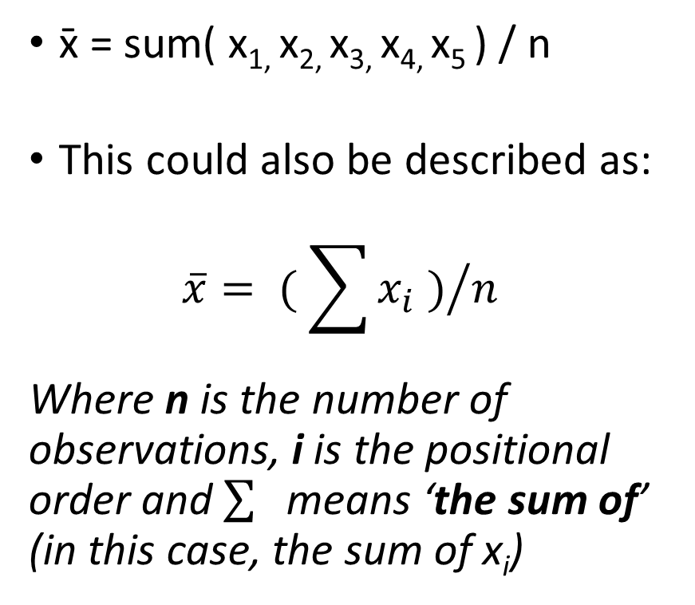
Central Tendency
True Population
x̄ = sum( x_{1,} x_{2,} x_{3,} x_{4,} x₅ ) / n
This could also be described as: $\overline{x}= {( \sum{x_{i}} )}/n$
Where n is the number of observations, i is the positional order and $\sum{s}$means ‘the sum of’ (in this case, the sum of x_{i})
x₁
x₂
x₃
x₄
x₅
Sample Mean x̄

Slide 22
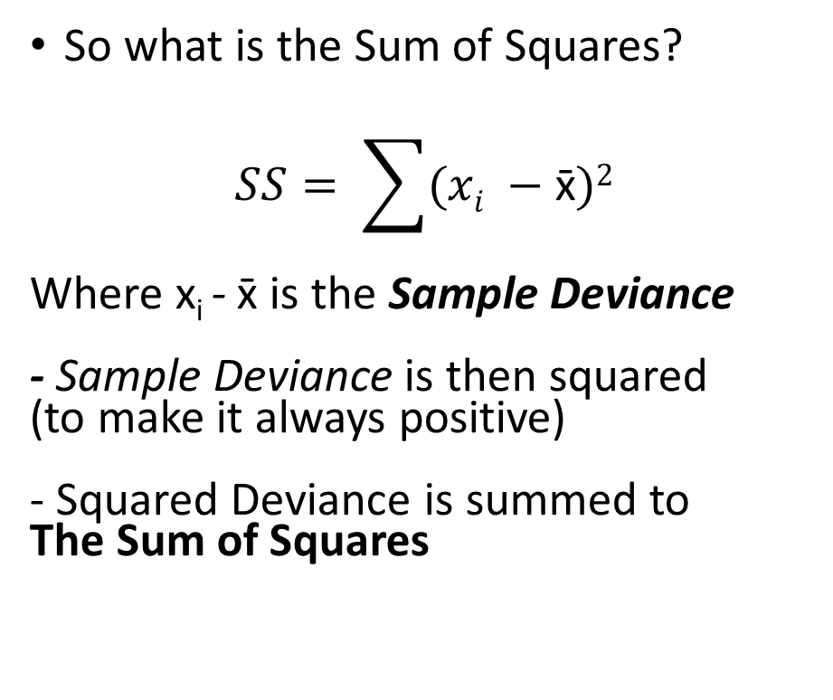
Central Tendency
True Population
So what is the Sum of Squares?
$$SS= \sum{(xi −\text{x}\text{̄}})2$$
Where x_{i} - x̄ is the Sample Deviance - Sample Deviance is then squared (to make it always positive) - Squared Deviance is summed to The Sum of Squares
x₁
x₂
x₃
x₄
x₅
Sample Mean x̄

Slide 23
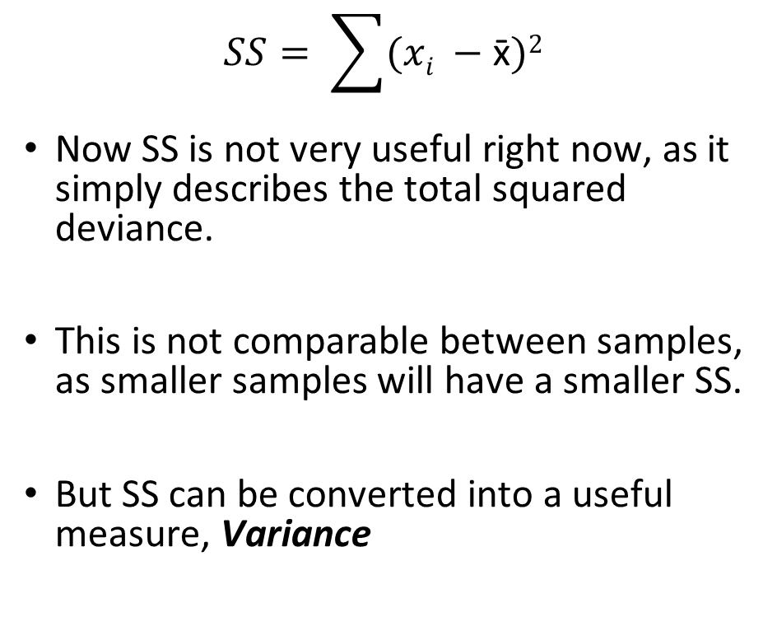
Central Tendency
True Population
$$SS= \sum{(xi −\text{x}\text{̄}})2$$
Now SS is not very useful right now, as it simply describes the total squared deviance.
This is not comparable between samples, as smaller samples will have a smaller SS.
But SS can be converted into a useful measure, Variance
x₁
x₂
x₃
x₄
x₅
Sample Mean x̄

Slide 24
Central Tendency
True Population
Variance describes how samples differ from the mean (using only positive numbers) as a proportion of the number of samples.
s² = SS / (n-1)
x₁
x₂
x₃
x₄
x₅
Sample Mean x̄

Slide 25
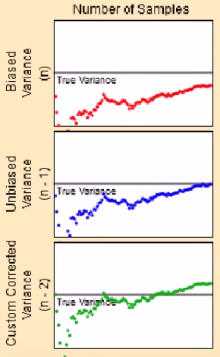
Central Tendency
Why n – 1?
If s² = SS / n, variance is under-estimated, even with large sample sizes i.e., see gap between red variance and true-variance – horizontal line
If s² = SS / (n-1), population variance may be accurately approximated from the sample. i.e., given the same number of samples, the blue variance meets the true-variance
We term these bias and unbiased estimates of variance, respectively.

Slide 26
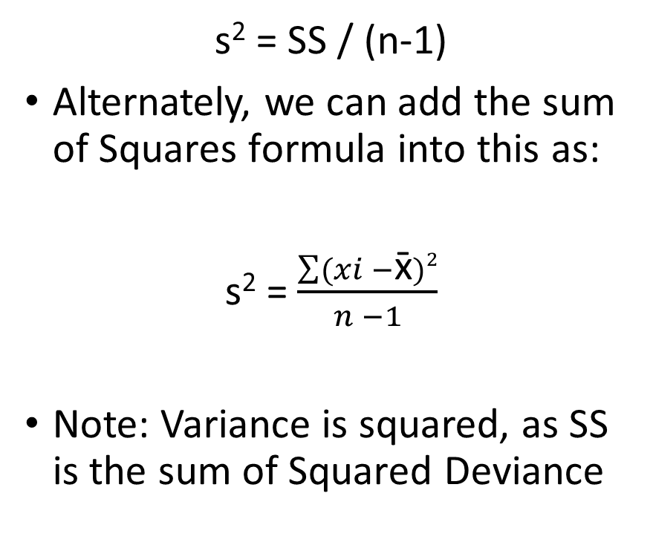
Central Tendency
True Population
s² = SS / (n-1)
Alternately, we can add the sum of Squares formula into this as:
s² = $\frac{\sum{(xi −\text{x}\text{̄}})2}{n −1}$
Note: Variance is squared, as SS is the sum of Squared Deviance
x₁
x₂
x₃
x₄
x₅
Sample Mean x̄

Slide 27
Central Tendency
True Population
While Variance s² describes spread in the data, it measures in squared units.
Squared units are hard to compare, e.g., Compare Dollars Squared or Height Squared.
To get around this, we convert the data back to the same format as the mean. This is the Standard Deviation
x₁
x₂
x₃
x₄
x₅
Sample Mean x̄

Slide 28
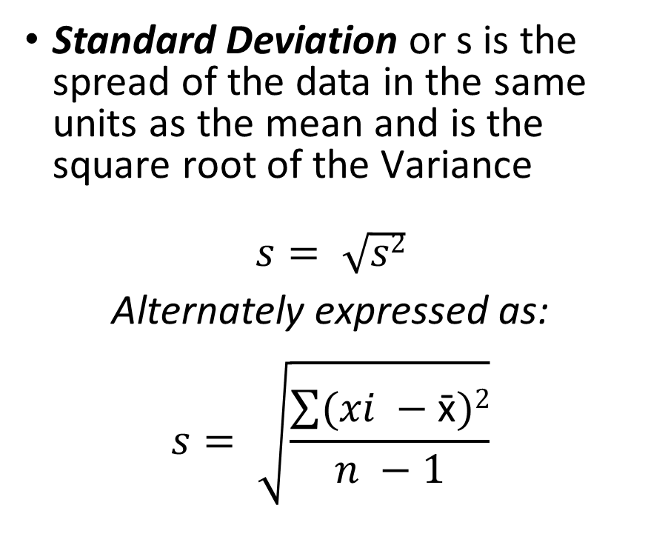
Central Tendency
True Population
Standard Deviation or s is the spread of the data in the same units as the mean and is the square root of the Variance
$$s= \sqrt{s2}$$
Alternately expressed as: $$s= \sqrt{\frac{\sum{(xi −\text{x}\text{̄}})2}{n −1}}$$
x₁
x₂
x₃
x₄
x₅
Sample Mean x̄

Slide 29

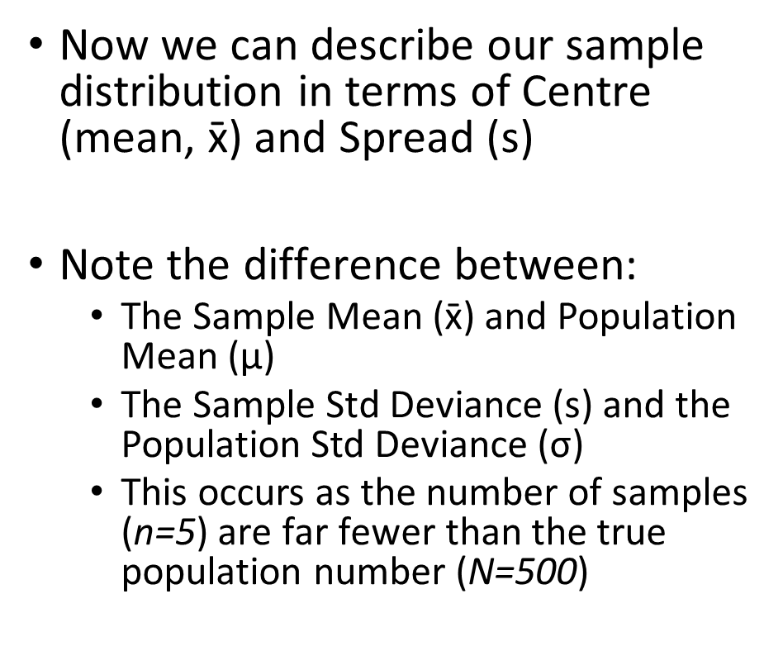



Central Tendency
True Population
$$\text{True} \text{Mean} \text{μ}$$
Now we can describe our sample distribution in terms of Centre (mean, x̄) and Spread (s)
Note the difference between:
The Sample Mean (x̄) and Population Mean ($\text{μ}$)
The Sample Std Deviance (s) and the Population Std Deviance ($\text{σ}$)
This occurs as the number of samples (n=5) are far fewer than the true population number (N=500)
$$\text{σ}$$
$$\text{σ}$$
$$\text{True} \text{Std} \text{Dev}$$
x̄
s
s
x₁
x₂
x₃
x₄
x₅

Slide 30
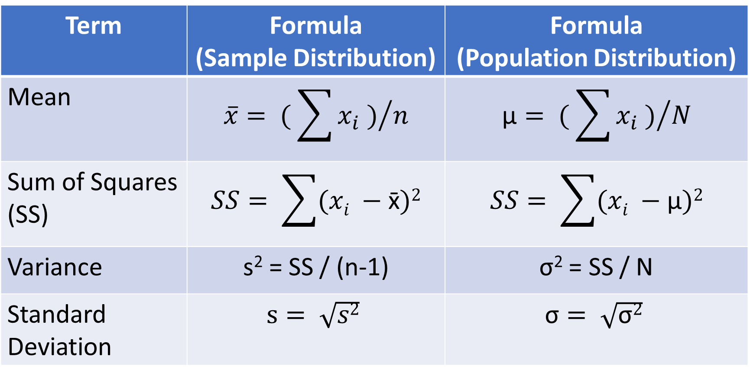
Central Tendency – Formula Review
Term | Formula (Sample Distribution) | Formula (Population Distribution)
Mean | $$\overline{x}= {( \sum{x_{i}} )}/n$$ | $$\text{μ}= {( \sum{x_{i}} )}/N$$
Sum of Squares (SS) | $$SS= \sum{(xi −\text{x}\text{̄}})2$$ | $$SS= \sum{(xi −\text{μ}})2$$
Variance | s² = SS / (n-1) | σ² = SS / N
Standard Deviation | $$s= \sqrt{s2}$$ | $$\text{σ}= \sqrt{\text{σ}2}$$

Slide 31
Central Tendency
Ok, now lets apply what we have learnt.
Lets give our theoretical distribution some values (see figure)
Now lets calculate the
Mean
Sum of Squares
Variance
Standard Distribution
1
14
17
21
32

Slide 32
Central Tendency
Same Data, but as a table
Data Point X_{i} | Value
X₁ | 1
X₂ | 14
X₃ | 17
X₄ | 21
X₅ | 32
1
14
17
21
32

Slide 33

Example. Mean
Data Point X_{i} | Value
X₁ | 1
X₂ | 14
X₃ | 17
X₄ | 21
X₅ | 32
Mean x̄ | 17
Sum of Squares (SS)
Variance (s²)
Std Deviation (s)
$$\overline{x}= {( \sum{x_{i}} )}/n$$
$\overline{x}$ = ( 1 + 14 + 17 + 21 + 32 ) / 5
$\overline{x}$ = 85 / 5
$\overline{x}$ = 17

Slide 34

Example. Sum of Squares
Data Point X_{i} | Value
X₁ | 1
X₂ | 14
X₃ | 17
X₄ | 21
X₅ | 32
Mean x̄ | 17
Sum of Squares (SS) | 533
Variance (s²)
Std Deviation (s)
$$SS= \sum{(xi −\text{x}\text{̄}})2$$
$SS$= ( 1 – 17 )² + ( 14 – 17)² +
( 17 – 17 )² + ( 21 – 17)² + ( 32 – 17 )²
$SS$= 256 + 6 + 0 + 16 + 255
$SS$= 533

Slide 35

Example. Variance
Data Point X_{i} | Value
X₁ | 1
X₂ | 14
X₃ | 17
X₄ | 21
X₅ | 32
Mean x̄ | 17
Sum of Squares (SS) | 533
Variance (s²) | 133.25
Std Deviation (s)
$$\text{s}\text{2} \text{= }\text{SS}\text{ / (}\text{n}\text{−}\text{1}\text{)}$$
s² = 533 / (5 – 1)
s² = 533 / 4
s² = 133.25

Slide 36

Example. Standard Deviance
Data Point X_{i} | Value
X₁ | 1
X₂ | 14
X₃ | 17
X₄ | 21
X₅ | 32
Mean x̄ | 17
Sum of Squares (SS) | 533
Variance (s²) | 133.25
Std Deviation (s) | 11.54
$$s= \sqrt{s2}$$
s = $\sqrt{133.25}$
s = 11.54339638
s = 11.54 (2dp)

Slide 37
Example.
Mean x̄
17
Data Point X_{i} | Value
X₁ | 1
X₂ | 14
X₃ | 17
X₄ | 21
X₅ | 32
Mean x̄ | 17
Sum of Squares (SS) | 533
Variance (s²) | 133.25
Std Deviation (s) | 11.54
Std Dev. s
11.54
s
s
1
14
17
21
32

Slide 38
Questioning Basic Stats? That’s OK!
Email Me: PaulGarrett2016@gmail.com

